Slide 1
Welcome to TeachingBooks
Resources that personalize children's and young adult books

Slide 2
Deepen Connections
Discover how TeachingBooks supports your curriculum while enriching connections between everyone and the books they are reading.

Slide 3
Our Mission
The TeachingBooks mission is to equitably give all readers insights and opportunities that deepen their understanding and joy of the books they are reading.

Slide 4
Today’s Takeaways
How to …
Sign in for all Educators and Students
Search to find resources for your books
Share instant access to resources
Browse to identify books with resources
Create a reading list

Slide 5

Introductory Video (3 min)
*Also available in Spanish

Slide 6

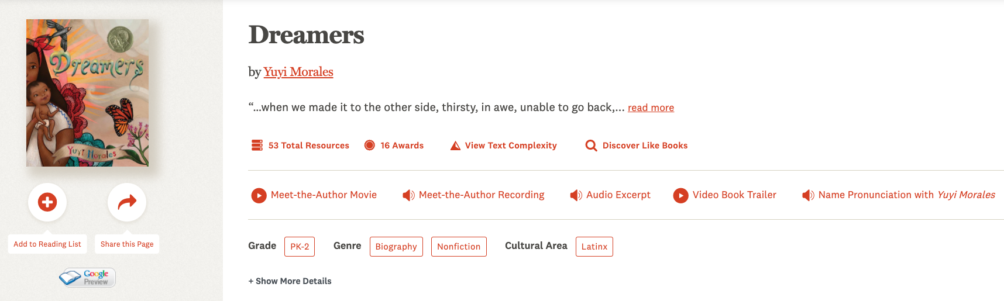
Search
Resources for the books you are reading
Notes:
Here is a sample book page. To view more resources, select the + signs on the right.

Slide 7
Sign in
An Educator Login allows you to share, customize, and learn more about how TeachingBooks can support and enrich literacy.
Go to www.TeachingBooks.net/Login
Enter your work email
Start customizing!

Slide 8
Explore Resources
TeachingBooks Original Resources
Multi-Leveled Lessons
Book Guides, Activities, and Lessons
Book Readings
Book Trailers
Vocabulary Lists

Slide 9
Turn and Talk
What resources can you use to support what you are teaching now?

Slide 10
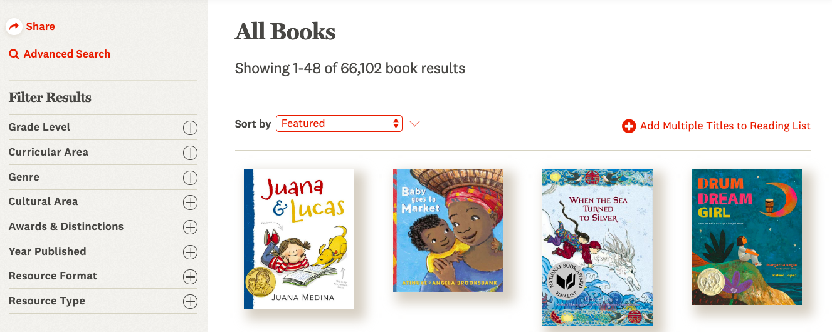
Browse
Browse to find resources for books, authors, lists, series, awards, and collections.
Filter with tools on the left.

Slide 11
Turn and Talk
Discover resources by Browsing by Grade Level, Cultural Experience, Resource Type and more.

Slide 12
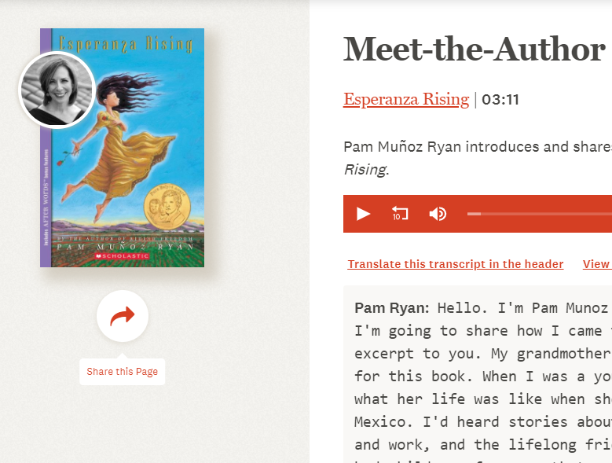
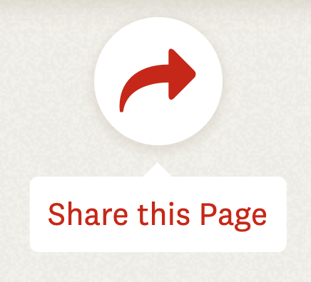
Share Instant Access
Use the Share Tool anywhere you see it, to provide direct access to the page or resource.

Slide 13
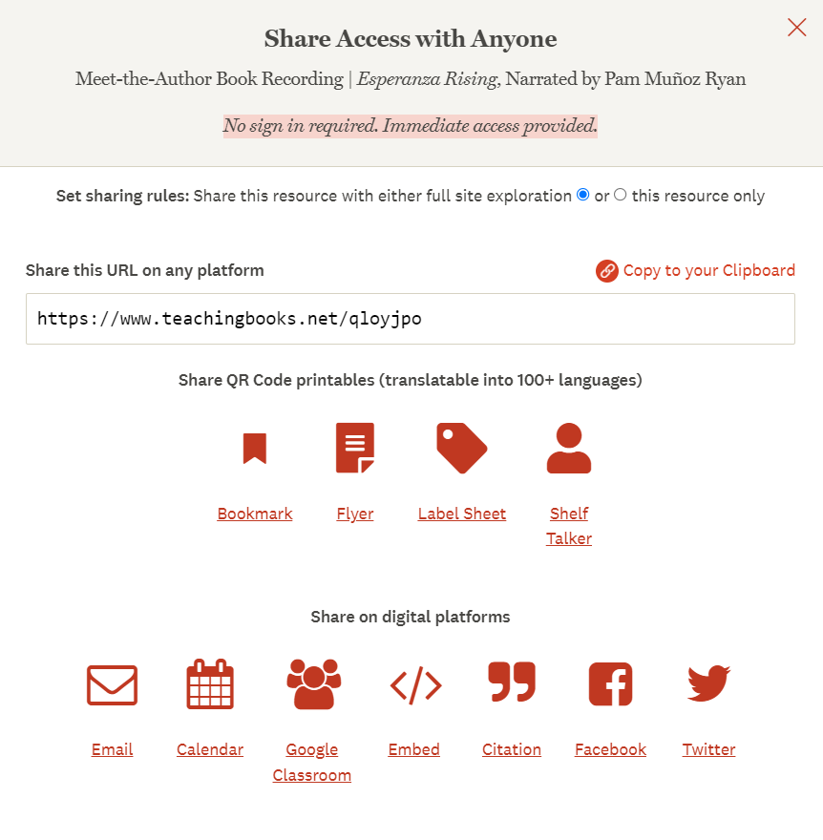

Slide 14
Your Turn
Locate a resource and use the sharing tools to share that resource with someone.

Slide 15
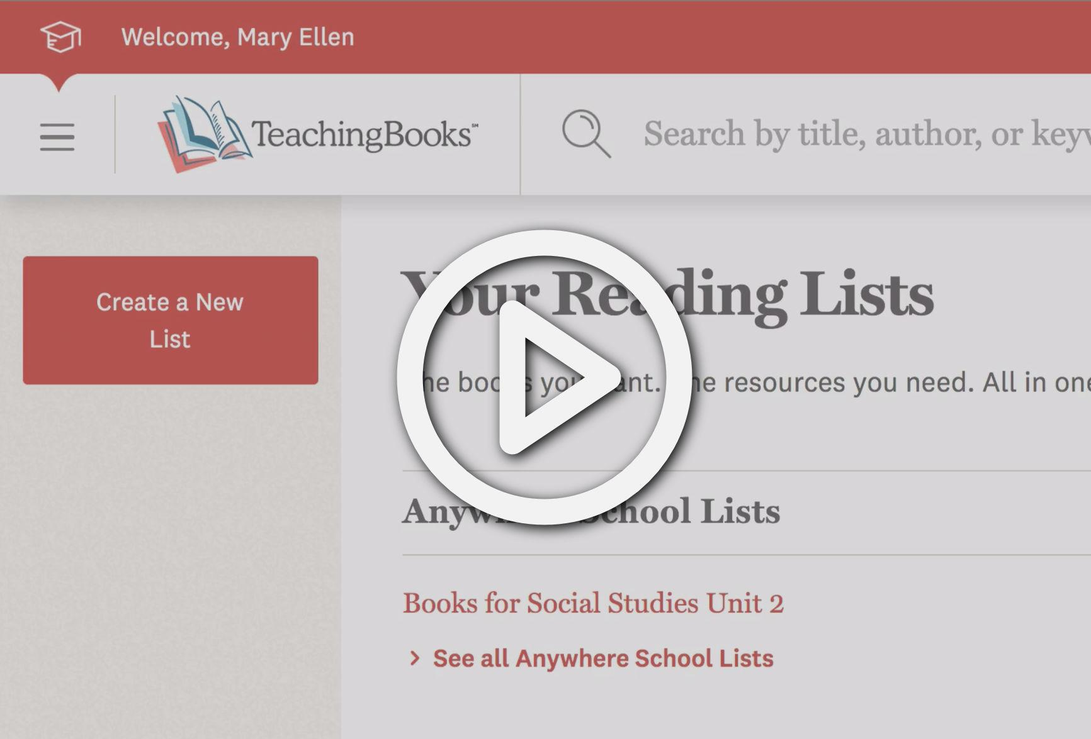
Create a Reading List
Watch to learn how to create your own list with the books you are teaching.

Slide 16
Your Turn
Create a list based on the titles you will teach this year.
Share the list with a colleague.

Slide 17

Access on Your Mobile Device
On any device browser, go to: www.TeachingBooks.net
Select the browser’s share button
Select “Add to Home Screen”

Slide 18
Today’s Take-aways
Today we learned to …
Sign in for all Educators and Students
Search to find resources for your books
Share instant access to resources
Browse to identify books with resources
Create a reading list

Slide 19
Thank You!
We love to hear from you.
Please reach out at any time.
Email: accounts@TeachingBooks.net
216-573-6886 (Press 2)
866-269-5794 (Press 2)

